Slide 1
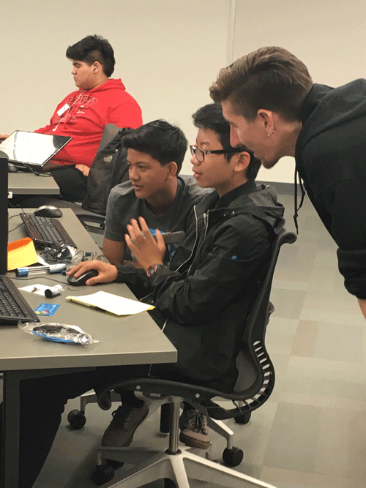
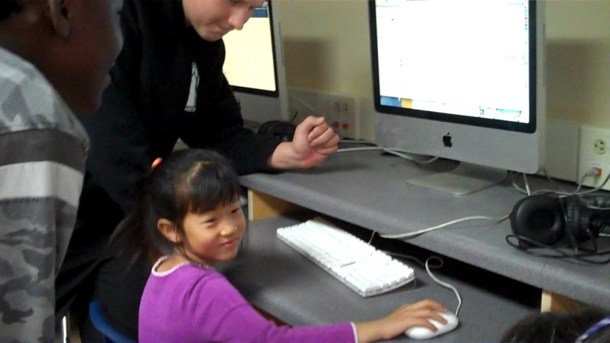
San Diego Unified Computer Science for Every Student
CaVE Grant October 2016

Slide 2
Strategy
Implement goal with strategic planning in the following areas:
Pathways
Professional Development
Promotion
Partnerships

Slide 3
Pathways From Middle School to High School
High Schools with AP CS Principles
Middle Schools with Coding
2014 – 2015 - 4 schools
2015-2016 - 9 schools
2016-2017 - 10 schools
Courses
AP Computer Science Principles in all ICT pathways
All ICT courses are UC a-g
Articulated credit – Foundations of IT
2014 – 2015 - No schools
2015-2016 - 2 schools
2016-2017 - 5 schools
Courses New pilot Intro to Coding

Slide 4
Professional Development Gamify It – Make it Social – Storify It
Hands-on Virtual Reality
San Diego Writing Project AP Explore Task

Slide 5
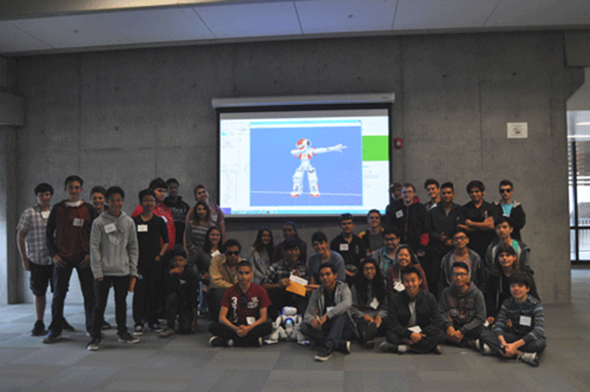
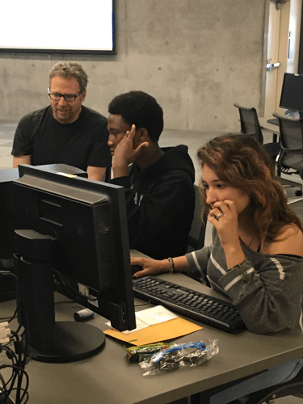
Promotion
District
Administrators
Counselors
Parents
Students
Community
Hour of Code – CS Education Week
Robot Coding Competition

Slide 6
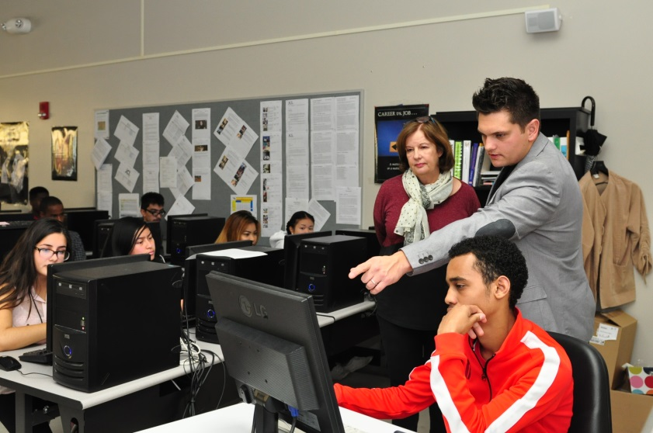
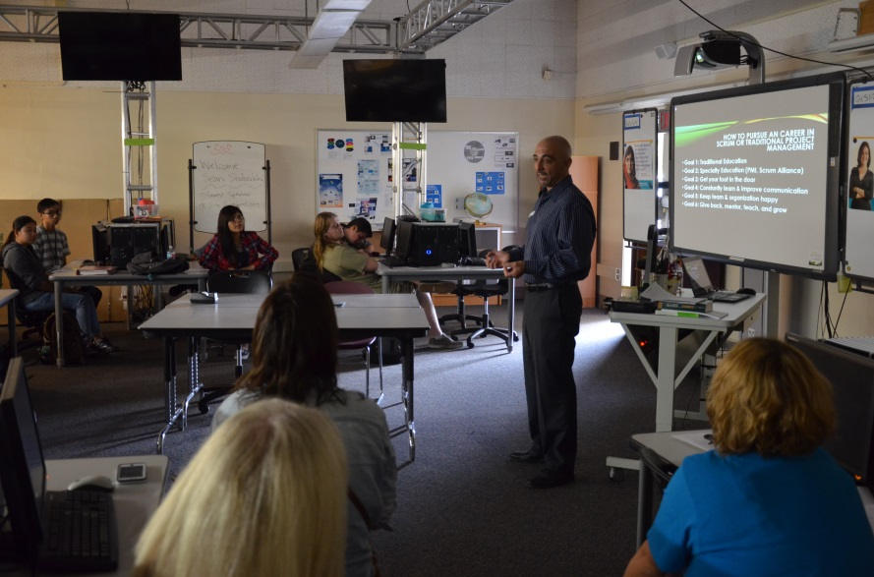
Partnerships
Industry Advisory Board
Junior Achievement
Guest Speakers
Field Trips
Mentors
Workforce Partnership
Internships

Slide 7
Next Steps - Goals
Credentialing
Increase internships
Articulated credit for applicable ICT courses

Slide 8
Contact
For more information
Gail Lake
Program Specialist College, Career, Technical Education
San Diego Unified
glake@sandi.net

